Slide 1


ALAN VLADIMIR PALAFOX GARDUÑO
24/11/2024

Slide 2

Outline
Executive Summary
Introduction
Methodology
Results
Conclusion
Appendix

Slide 3
Executive Summary
Summary of methodologies
For this project, I'm taking on the role of Data Scientist to analyze data from SpaceX, Elon Musk's company, with the goal of creating a competitor named Space Y. The study was carried out using data extraction through APIs and web scraping, data analytics, and machine learning modeling algorithms.
Summary of all results
The analysis revealed that many launches failed for various reasons, including rocket weight, rocket system model, launch location, and the orbit in which the rocket would travel through space.

Slide 4
Introduction
Project background and context
Predict whether the first stage of the Falcon 9 rocket will successfully land. SpaceX advertises Falcon 9 rocket launches on their website at a cost of $62 million, while other providers charge over $165 million per launch. A significant portion of this cost reduction is due to SpaceX's ability to reuse the first stage. Therefore, if we can predict whether the first stage will land, we can estimate the cost of a launch.
Problems you want to find answers
By analyzing historical launch data from SpaceX, we can predict whether the first stage of the Falcon 9 launch will successfully land, allowing us to estimate the launch cost. This information could give the alternative company, SpaceY, a competitive edge against SpaceX in the rocket launch market.

Slide 5

Section 1

Slide 6
Methodology
Executive Summary
Data collection methodology:
The data was collected using SpaceX's REST API and extracting information from Wikipedia through web scraping
Perform data wrangling
The data was processed using the Pandas and NumPy libraries. One-Hot Encoding was used to remove unnecessary columns. Additionally, the data was normalized and standardized.
Perform exploratory data analysis (EDA) using visualization and SQL
Seaborn and Matplotlib were used for data visualization, and SQL was utilized for data extraction and manipulation.
Perform interactive visual analytics using Folium and Plotly Dash
The Folium and Dash libraries were used.
Perform predictive analysis using classification models
The main library used was Scikit-Learn. First, the data was split into predictor variables and the target variable., The data was normalized.
The dataset was divided into training and testing sets.
GridSearchCV was used to find the best hyperparameters for the models.
The classification methods were compared, and the one with the best performance and results was selected.

Slide 7
Data Collection
The data was primarily obtained from two sources:
SpaceX API: An open-source REST API that contains historical information on past launches.
Web Scraping: Information publicly available on the Wikipedia website was extracted.
SPACE X API
JSON FILE FORMAT
DATAFRAME / SQLITE
WIKYOEDIA WEB SCRAPING
TXT FILE FORMAT

Slide 8
Data Collection – SpaceX API
The data was extracted from the API using the Pandas, NumPy, and Requests libraries. A GET URL request was made with the Requests library, and the information was then extracted in JSON format. Finally, the data was converted into a DataFrame and stored in a .csv file or an SQL database.
Add the GitHub URL of the completed SpaceX API calls notebook (must include completed code cell and outcome cell),
SPACE X API
Url GET Request
JSON Response
DataFrame
Data prepared for processing amd analysis

Slide 9
Data Collection - Scraping
The data was extracted through web scraping using the Pandas, NumPy, Requests, and Beautiful Soup libraries. A GET URL request was made using the Requests library, and the information was extracted in TEXT format. Then, Beautiful Soup was used to parse the data into a table based on HTML tags. Finally, the data was converted into a DataFrame and stored in a .csv file or an SQL database.
Add the GitHub URL of the completed web scraping notebook
Wikypedia webpage
Url GET Request
TEXT Response
Beautiful Soup
DataFrame
Data prepared for processing amd analysis

Slide 10
Data Wrangling
1. Loading the collected dataset
The Pandas and NumPy libraries were loaded to handle the data obtained in the previous stage. The data was cleaned, information was validated, missing values were filled in, and columns with irrelevant values for machine learning modeling were removed.
Add the GitHub URL of your completed data wrangling related notebooks
2. Identify and calculate the percentage of the missing data
3. Maintain columns with relevant values ​​for modeling
4. Calculate general statistics parameters to know relevant information on some columns.

Slide 11
EDA with Data Visualization
Visualize the relationship between :
The EDA process was carried out using various visualizations with the Seaborn and Matplotlib libraries to identify correlations between attributes and the target variable. Additionally, categorical variables were transformed into dummy variables, and feature reduction was performed.
Add the GitHub URL of your completed EDA with data visualization notebook
Flight Number
Succes Rate
Payload
Flight Number
Yearly Trend
Launch Site
Orbit
Launch Site
Orbit
Launches Succes
VS

Slide 12
EDA with SQL
SQL Queries
Display the names of the unique launch sites in the space mission
Display 5 records where launch sites begin with the string 'CCA’
Display the total payload mass carried by boosters launched by NASA (CRS)
Display average payload mass carried by booster version F9 v1.1
List the date when the first succesful landing outcome in ground pad was acheived.
List the names of the boosters which have success in drone ship and have payload mass greater than 4000 but less than 6000
List the total number of successful and failure mission outcomes
List the names of the booster_versions which have carried the maximum payload mass. Using a subquery
List the records which will display the month names, failure landing_outcomes in drone ship ,booster versions, launch_site for the months in year 2015
Rank the count of landing outcomes (such as Failure (drone ship) or Success (ground pad)) between the date 2010-06-04 and 2017-03-20, in descending order
The SQL queries used for the EDA stage are listed on the right:
Add the GitHub URL of your completed EDA with SQL notebook

Slide 13
Build an Interactive Map with Folium
Creation of an interactive map with Folium
I started by creating a global map and then plotted the four launch sites with their labels.
Colored markers were added to represent the failed and successful landings of rocket launches at these sites.
Finally, the distance was calculated between the coastline, the road, and the nearest city to the CCAF LC-40 launch site.
The launch sites are:
In this stage, the Folium library was used to visualize geospatial data. By adding color-coded markers to the launch sites, it became easier to pinpoint their locations and better understand the data.
Add the GitHub URL of your completed interactive map with Folium map
Launch Sites | Lat | Long
CCAFS LC-40 | 28.562302 | -80.577356
CCAFS SLC-40 | 28.563197 | -80.576820
KSC LC-39A | 28.573255 | -80.646895
VAFB SLC-4E | 34.632834 | -120.610745

Slide 14
Build a Dashboard with Plotly Dash
1. A dropdown menu was added to enable the selection of a Launch Site for the Dashboard.
2. A pie chart was included to display the total successful launches for each site.
3. A slider was added to select payload within a specified range.
4. Finally, a scatter plot was created to show the correlation between payload and launch success.
Add the GitHub URL of your completed Plotly Dash lab.

Slide 15
Predictive Analysis (Classification)
Loading cleaned data
Standardize data to prevent bias
Splitting the data into 20% and 80% for testing and training, respectively
Apply 4 different classification algorithms:
Logistic Regression (LR)
Suport Vector Machine (SVM)
Decision Tree (DT)
K Nereast Neighbors (KNN)
Using Grid Search to find best hyper parameters
Evaluating techniques applying Confusion matrix, F1 score, Jaccard Score and use the best algorithm
1. Loading cleaned data
2. Standarize data
3. Splitting data into test and training
4. Apply classification algorithms
5. Grid Search CV to find best parametera
6. Evaluate best technique

Slide 16
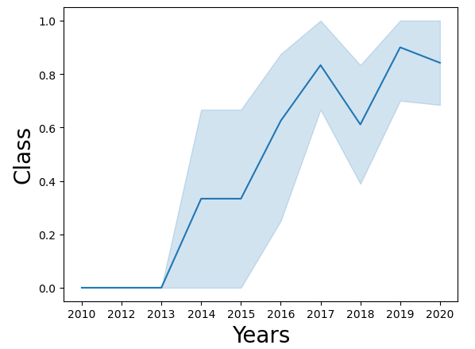
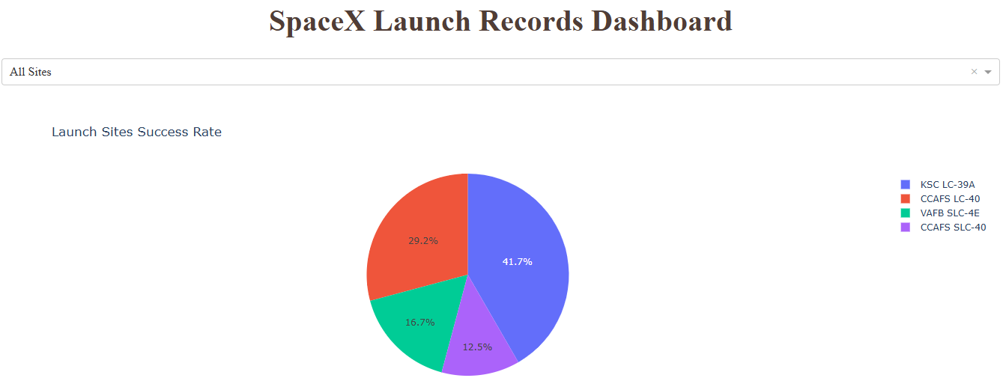
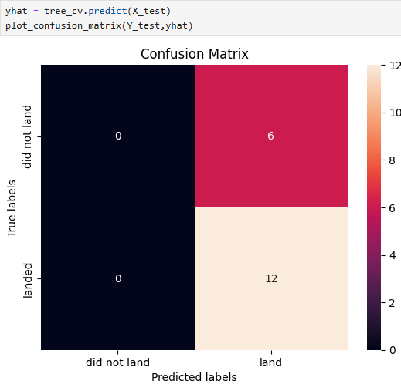
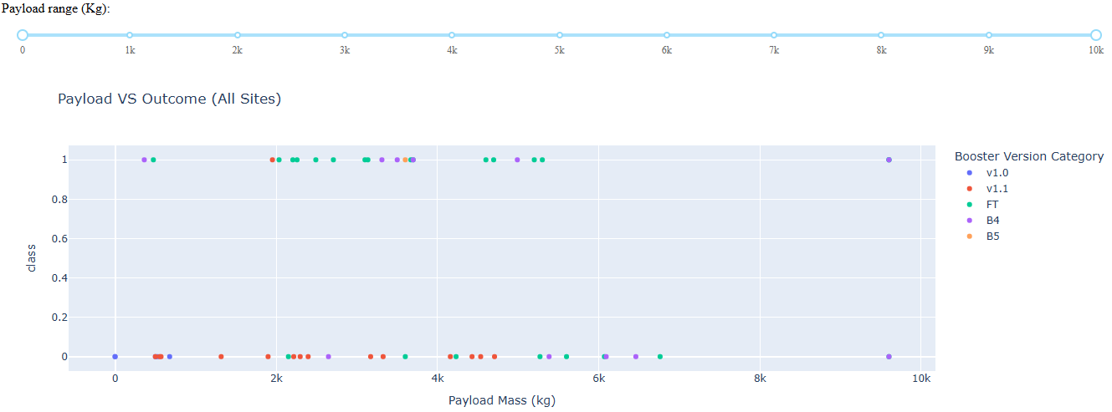
Results
Exploratory data analysis results
Interactive analytics demo in screenshots
Predictive analysis results
The exploratory data analysis revealed that successful landings have been steadily increasing since 2013. The best classification algorithm for making accurate predictions is the Decision Tree.

Slide 17

Section 2

Slide 18
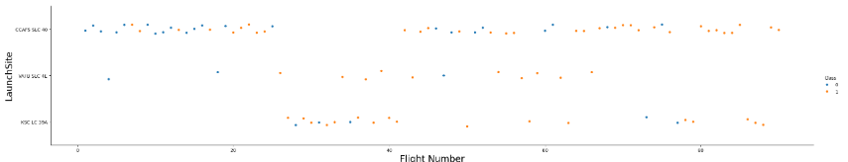
Flight Number vs. Launch Site
Plot of Flight Number vs. Launch Site
CCAFS SLS 40: This is the site with the highest number of launches by SpaceX, making it the site with the most successful landings.
VAFB SLC 4E: This is the site with the fewest launches overall, with only three successful landings and ten failures.
KSC LC 39A: This is the most recently used launch site, and it has fewer successes compared to failures at the same site.

Slide 19
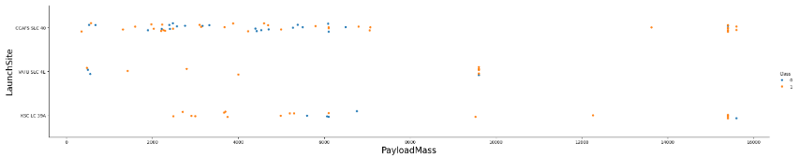
Payload vs. Launch Site
Show a scatter plot of Payload vs. Launch Site
This chart clearly shows the relationship between rocket mass and landing success. The lighter the rocket, the higher the probability of success; the heavier the rocket, the greater the likelihood of failure

Slide 20
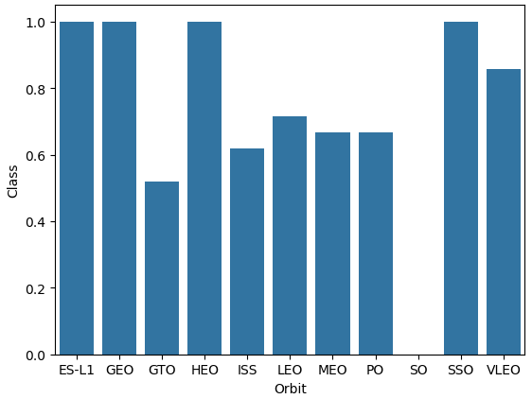
Success Rate vs. Orbit Type
Barplot – Orbit vs Class
The orbit followed by rockets during launch significantly impacts their landing success. Satellites in ES-L1, GEO, HEO, and SSO orbits have contributed to higher launch success rates. On the other hand, GTO is the orbit with the highest failure rate.

Slide 21
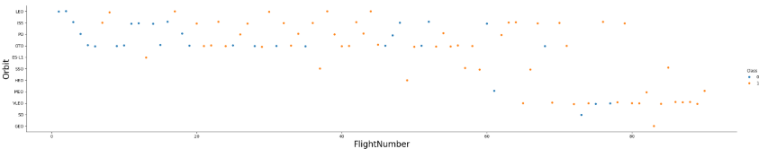
Flight Number vs. Orbit Type
Scatterplot - Flight number vs. Orbit type
This chart shows the number of flights and the orbits followed by the rockets. It’s clear that the orbits with the highest number of launches are the most successful, while the newer orbits tested in recent flights have only achieved four successful landings.

Slide 22
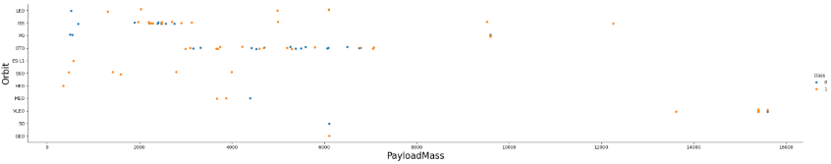
Payload vs. Orbit Type
Scatterplot – Payload vs. orbit type
This chart displays the mass of the rockets launched and the orbits they followed. It highlights that weight has a greater impact on launch success than the orbits, reaffirming the trend: the lighter the mass, the higher the success rate, while heavier rockets have a greater likelihood of failure

Slide 23

Launch Success Yearly Trend
Lineplot - Yearly average success rate
The success rate of rocket launches has been steadily increasing over time, with the upward trend starting in 2013. Since then, the probability of success has continued to grow.

Slide 24
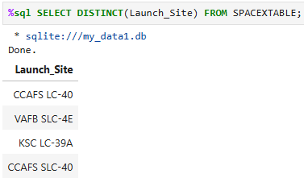
All Launch Site Names
Find the names of the unique launch sites

Slide 25
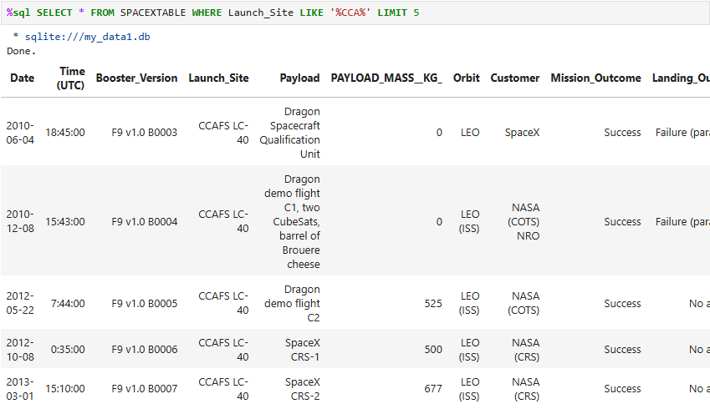
Launch Site Names Begin with 'CCA'
Find 5 records where launch sites begin with `CCA`

Slide 26
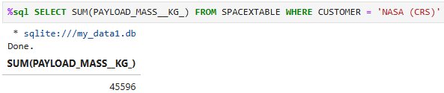
Total Payload Mass
Calculate the total payload carried by boosters from NASA

Slide 27
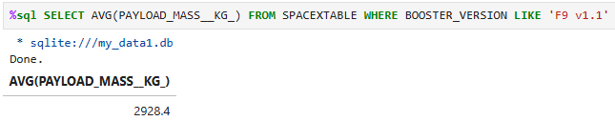
Average Payload Mass by F9 v1.1
Calculate the average payload mass carried by booster version F9 v1.1

Slide 28
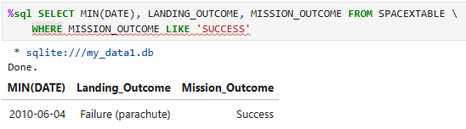
First Successful Ground Landing Date
Find the dates of the first successful landing outcome on ground pad

Slide 29
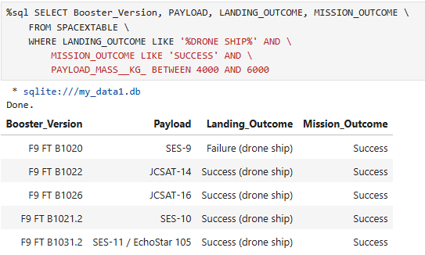
Successful Drone Ship Landing with Payload between 4000 and 6000
List the names of boosters which have successfully landed on drone ship and had payload mass greater than 4000 but less than 6000

Slide 30
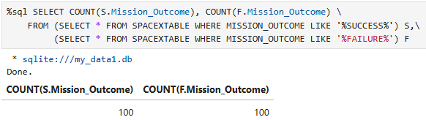
Total Number of Successful and Failure Mission Outcomes
Calculate the total number of successful and failure mission outcomes

Slide 31
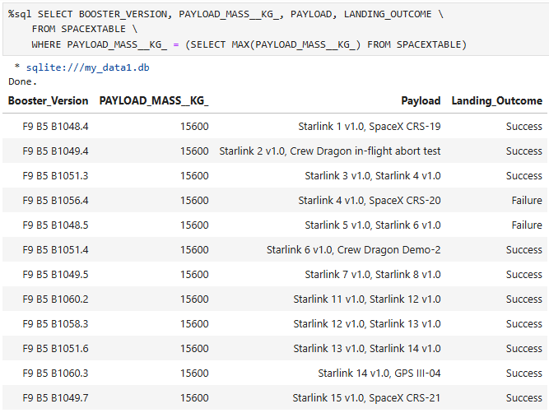
Boosters Carried Maximum Payload
List the names of the booster which have carried the maximum payload mass

Slide 32
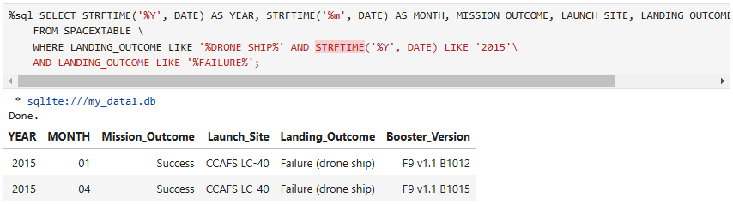
2015 Launch Records
List the failed landing_outcomes in drone ship, their booster versions, and launch site names for in year 2015

Slide 33
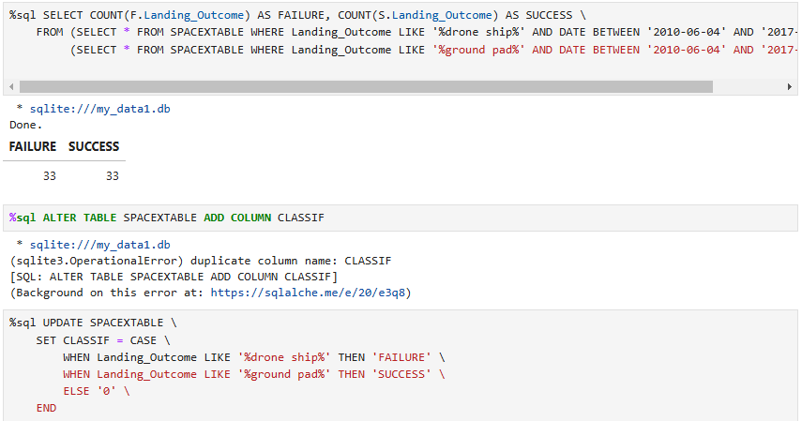
Rank Landing Outcomes Between 2010-06-04 and 2017-03-20
Rank the count of landing outcomes (such as Failure (drone ship) or Success (ground pad)) between the date 2010-06-04 and 2017-03-20, in descending order

Slide 34

Section 3

Slide 35

Folium Map: Launch Sites.
All SpaceX launches have taken place in the southeastern and southwestern regions of the U.S., specifically in California and Florida.

Slide 36
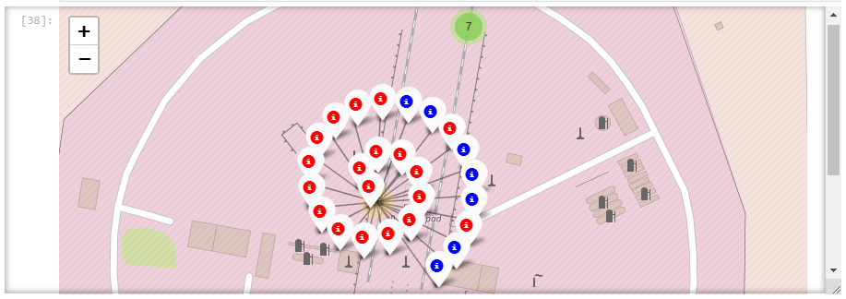
Folium Map: Success rate for each launch location
The flights were classified into two groups: Blue for successful landings and Red for failed landings.

Slide 37
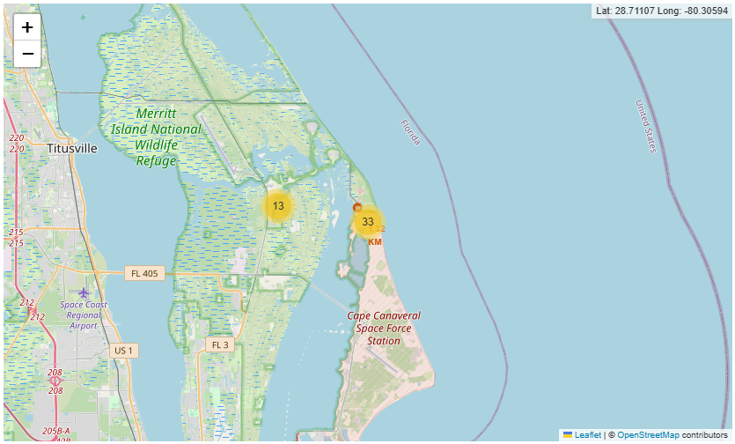
Folium Map: Closest Proximities to CCAFS LC-40
The distance between a launch site and the nearest road and coastline was calculated.

Slide 38

Section 4

Slide 39
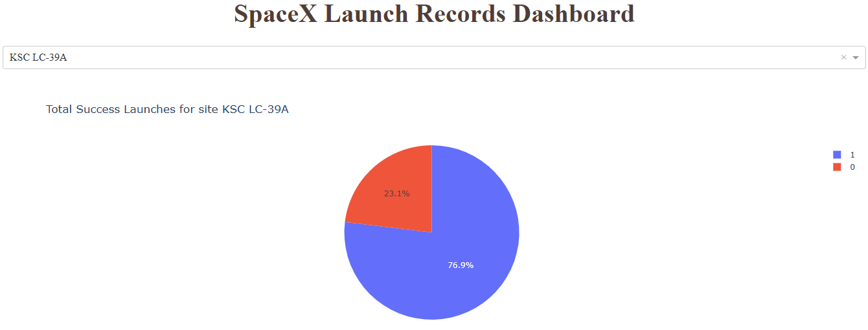
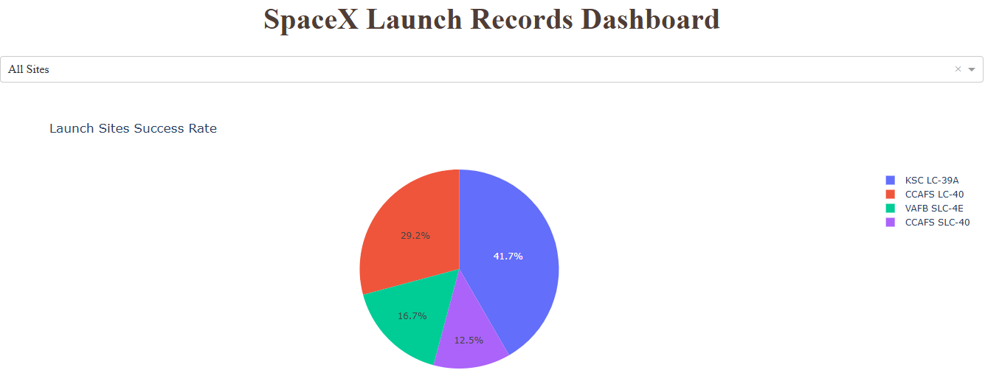
<Dashboard Screenshot 1>
A pie chart showing the percentage of launches conducted at each site.

Slide 40
<Dashboard Screenshot 2>
A pie chart showing the percentage of successful and failed landings at the site with the highest number of launches by SpaceX.

Slide 41
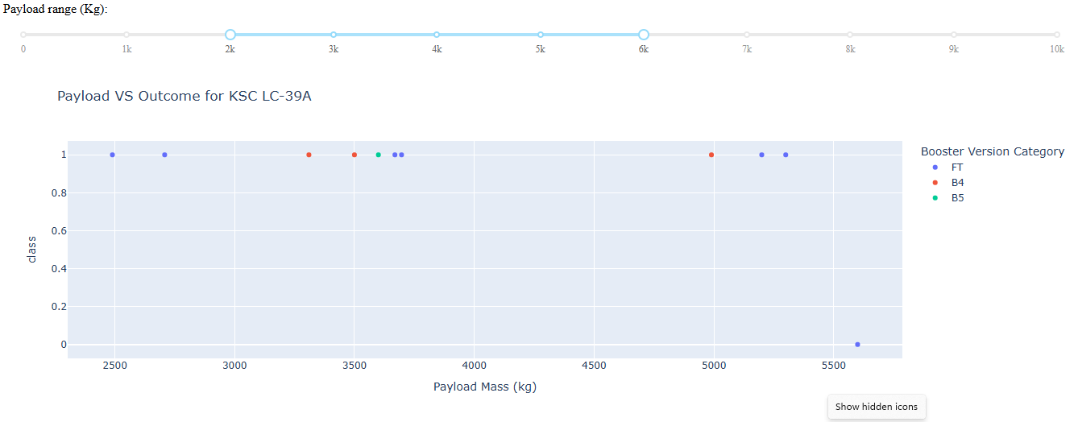
Dashboard: Launch success count for all sites
A chart showing the relationship between landing success and the rocket's mass in kilograms

Slide 42

Section 5

Slide 43
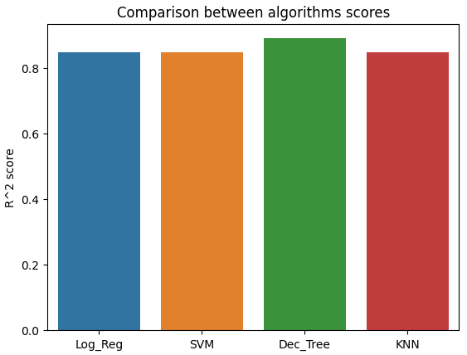
Classification Accuracy
The bar chart represents the accuracy percentage of each model trained on the data, aiming for greater precision in classifying the data and improving predictions on whether future landings will be successful or failed.

Slide 44
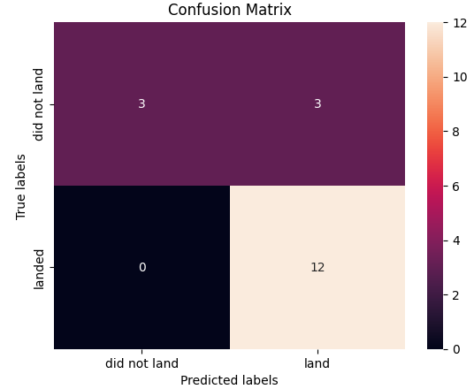
Confusion Matrix
The confusion matrix for the test data, using decision tree classification, as it was the model with the highest accuracy.

Slide 45
Conclusions
Point 1: The success rate of first stage landing leads to a huge probability of savings for future rocket launches.
Point 2: The attributes that can affect the success of a successful first stage landing are varied; in this case more than eighty attributes will be considered for the estimation of the calculations.
Point 3: SpaceX's Falcon 9 launch sites were all close to a highway, a railroad, and a coastline, making them easy to access and reduce transportation costs.
Point 4: SpaceX’s success rate has increased over the years, with the KSC LC-39A site having the highest success rate.
Point 5: Orbit and booster version greatly affect success rate

Slide 46


